Slide 1
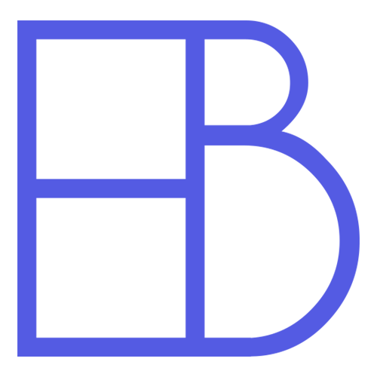
Electric Blocks
Engineering Release Review
Zachary Sugano and Christian Whitfield

Slide 2
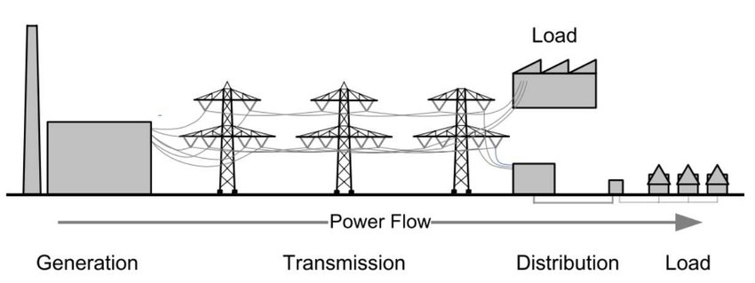
Project Objective
Enable the creation and use of realistic and accurate virtual reality models of electric power transmission, distribution, control, and usage scenarios for research and instruction purposes.

Slide 3
Background
Electric Blocks is useful for conducting a power-flow study: a numerical analysis looking at the electric flow of power in a system.
Electric Blocks enables the user to design and model power grids, which are interconnected networks that deliver electric power from producers to consumers. Using our mod, power-flow data is computed and results are displayed in-game.
Minecraft is the most popular game in the world, with over 100 million monthly active players, and can be modded. Minecraft presents a great environment for the goals we aim to achieve with Electric Blocks.

Slide 4
Value Proposition
Traditional tools used in design and simulation of power flow networks require a highly technical understanding of power flow behavior, and are not readily accessible to learners due to their cost and complex interface.
Electric Blocks is inherently simple, requires no coding knowledge, and provides results that are easy to interpret. The interactive and collaborative nature of Minecraft makes Electric Blocks a useful tool for designing, teaching and playing with power-flow simulations.

Slide 5
Key Requirements
Accurately model and simulate power flow.
Easy to use.
Provide real-time interaction and collaboration.
Completely free and open source.

Slide 6
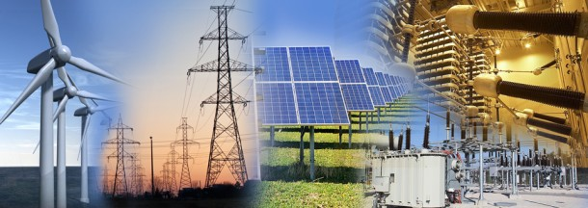
Requirement 1: Accuracy
Our project must be usable for research and instruction purposes. To meet this requirement, our project must accurately model and simulate power flow as it would occur in the real world.
Our lack of power engineering experience meant that a critical component of our project was individual research so we could learn how to approach this problem.

Slide 7
Requirement 1: Analysis
Our early research informed us that performing power flow studies is conceptually and computationally complex. We decided early on that we should not waste time attempting to construct our own system and that we should use an open source library instead.
Java is the programming language used to create Minecraft mods and many power flow libraries were written in other languages. This helped lead us to the conclusion that we would need to write 2 different pieces of software. The first program would be the Electric Blocks mod which provided the user interface and the second program would be EBPP which runs the simulation software.

Slide 8


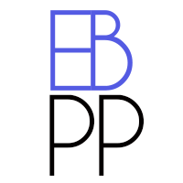


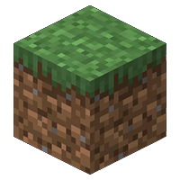

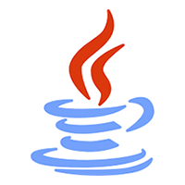
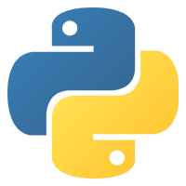
Overall Software Architecture

Slide 9
Why use two separate pieces of software?
Separating our software out into two independent, but cooperative, pieces of software confers a substantial number of benefits:
The simulation software can be run on a different machine than the player
Many players won’t need to install the simulation software at all
Eliminates OS dependent code and minimizes compatibility issues
Improves performance of simulations and Minecraft game
Creates lower coupling and higher cohesion
Enables modification and improvement of simulation software without requiring updates to Minecraft code.

Slide 10
Why did we choose PandaPower?
There are a number of open energy system models that we could have chosen, but we found that PandaPower was the clearly the best option because:
PandaPower is written in pure Python and developed to be cross-platform.
Power systems vary throughout the world and PandaPower is the only simulator we found that supports single phase, balanced 3 phase, AND unbalanced 3 phase power.
Many “open source” tools depend on commercial platforms to function. PandaPower does not and is entirely free and open source.
PandaPower is thoroughly tested against commercial software tools.

Slide 11
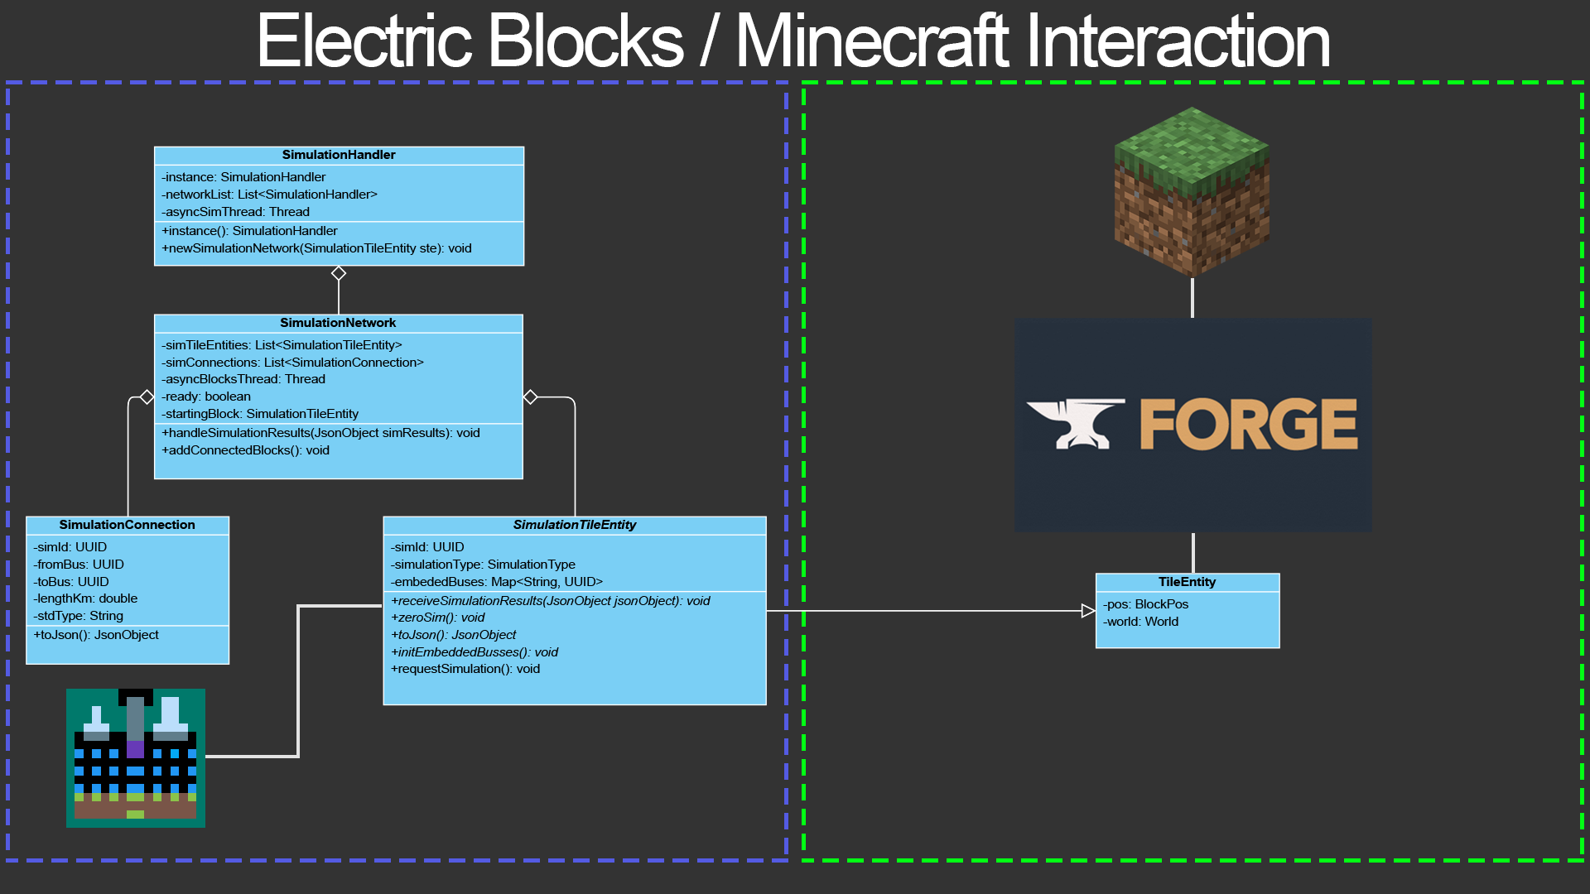

Slide 12
How does EBPP work?
EBPP listens for incoming simulation requests using Flask, a micro web framework, and starts a new thread to process the request.
In the new thread, EBPP parses the request to build the electrical network using PandaPower.
PandaPower then performs the load flow simulation and attempts to converge on a solution.
EBPP then extracts the results from the PandaPower network and stores them in a Python dictionary.
EBPP finally uses the results dictionary to construct the body of the response and returns the results to Electric Blocks.

Slide 13
How do Electric Blocks and EBPP communicate?
Both pieces of software communicate with each other using HTTP requests with the body encoded in JSON. A common standard was created for all request types.
The basic unit of information exchanged between each piece of software is a simulation request and simulation results. This communication standard is what allows Electric Blocks to ensure that the in-game state matches the real world accurately.
Other request types also exist such as keep alive requests to ensure that Electric Blocks can connect to the simulation server as well as error responses to handle various failure conditions. The standard is detailed in the documentation for EBPP.

Slide 14
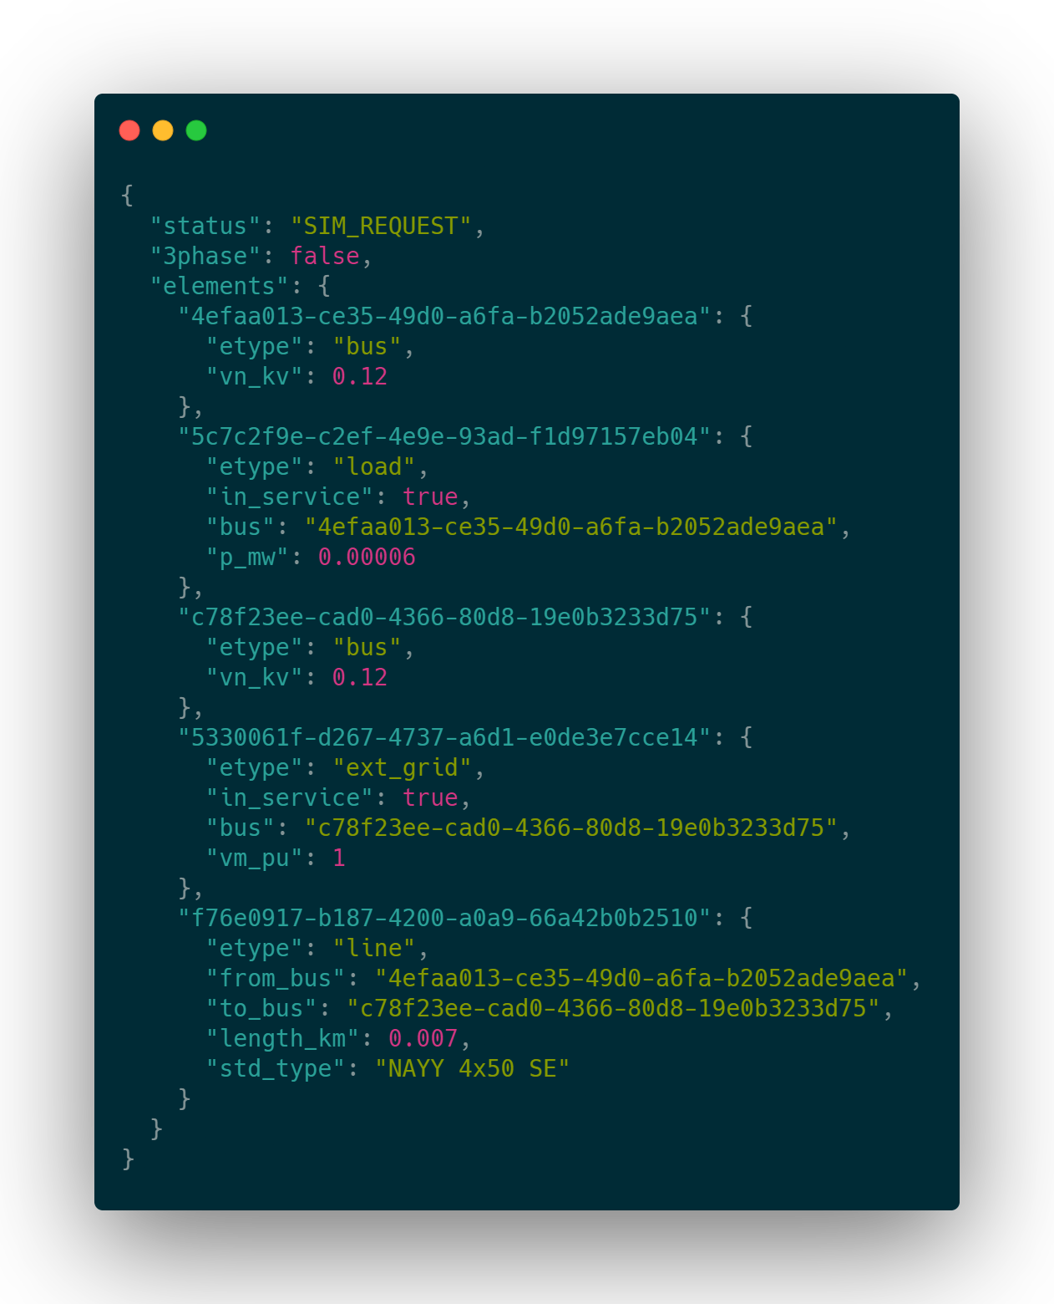
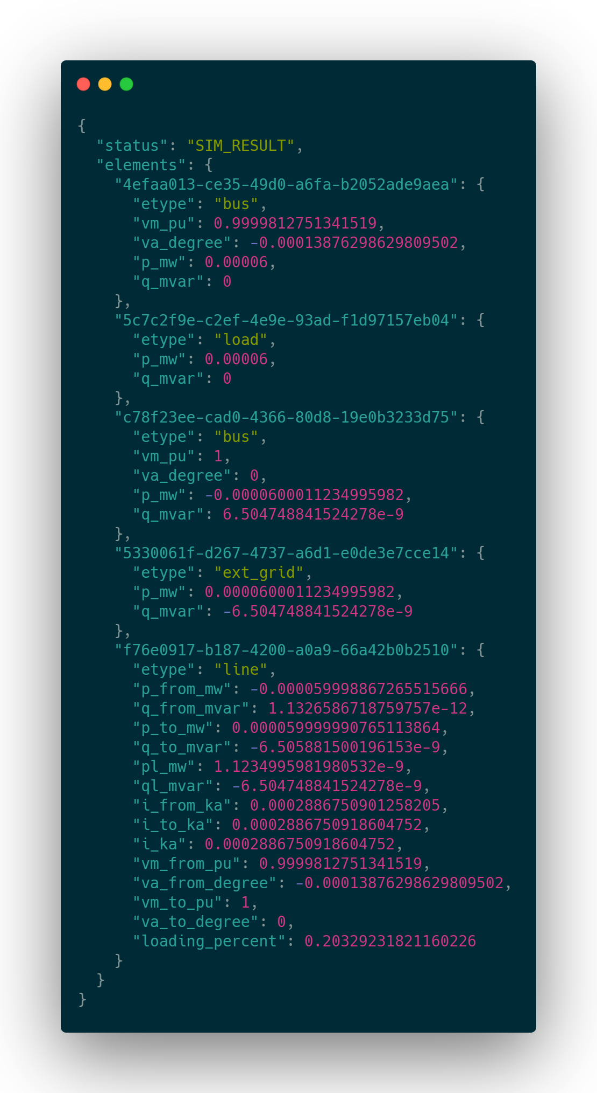
What do requests and responses look like?

Slide 15
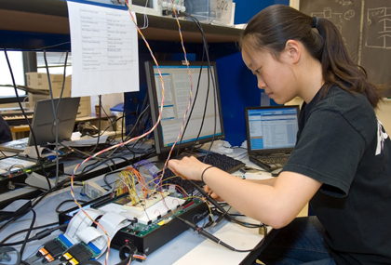
Requirement 2: Ease of Use
Our project must be useful for instruction purposes and so our target audience is mostly students. This means that many users of our software will have limited experience in power engineering.
Thus our software must be easy to use and should not require any coding.

Slide 16
Requirement 2: Analysis
While a lot is going on in the backend, the user experience is designed to be simple and intuitive.
Design and creation of power flow models is done by simply placing blocks from your inventory such as wires, grids, loads, etc.
Viewing, modifying, and simulating a network is all done using the Multimeter item. With this item equipped, you can retrieve and edit values like the voltage level or power consumption of a particular block in the network.

Slide 17
Basic Network Creation

Slide 18
Multimeter Toggle Demo

Slide 19
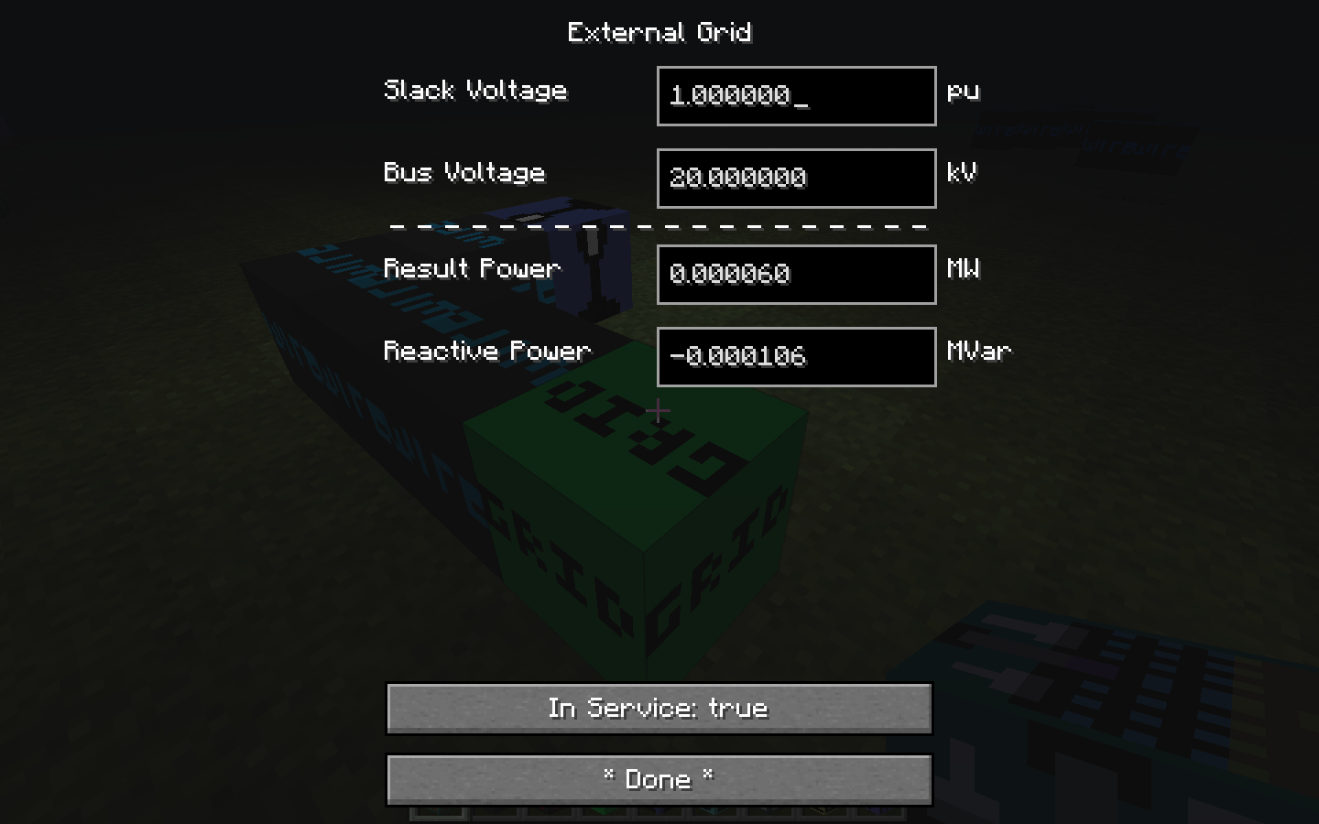
Multimeter Tool
The user can equip the multimeter and use it by right-clicking on an electric block, such as a grid block.
This interaction event causes input and output information to be displayed in a table format.
A dotted line partitions the inputs from the results. The user can type in the desired voltage values, toggle “In Service” to true, then press Done to update the changes.

Slide 20
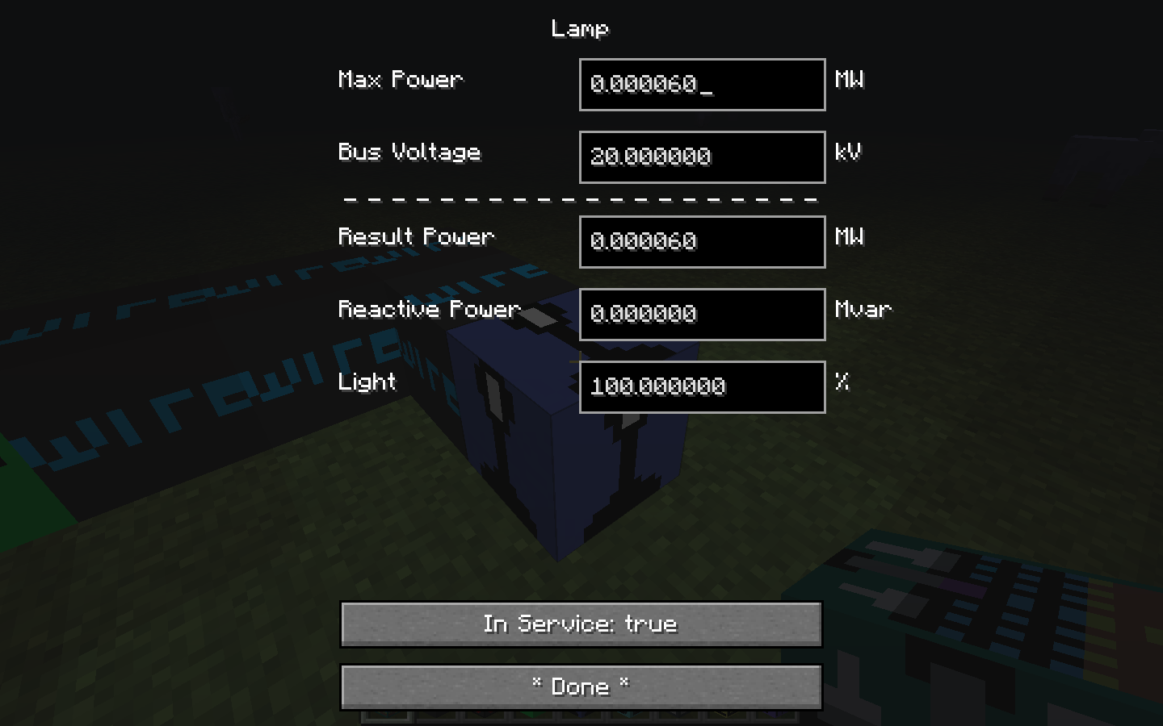

Slide 21
Multimeter GUI Demo

Slide 22

Requirement 3: Real-time Interaction and Collaboration
Both research and instruction are greatly enhanced when engineers receive real-time feedback and are able to collaborate on projects.
We were unable to find any other software that allowed multiple engineers to work on a single electrical network simultaneously. We’ve changed that.

Slide 23
Requirement 3: Analysis
Being able to experiment safely is an important part of the learning process. Electric Blocks provides an environment for engineers to rapidly prototype and try things out without any costs or danger involved.
Being able to experiment together is also just as important. We determined early on that real-time collaboration was a must for our project and so we have designed Electric Blocks to fully support multiplayer servers.

Slide 24
Real-time Feedback Demo

Slide 25
Multiplayer Support
The original model shown in this presentation was actually a simplified version of how the Electric Blocks system works. In reality our system actually requires 3 pieces of software running at any one time:
Electric Blocks Client Mod
Electric Blocks Server Mod
EBPP Simulation Server
To help keep things simple for end users, the client mod and the server mod are packaged into a single “universal” JAR (Java Archive) file. Some code is common to both mods and some is executed only on the client or server side.

Slide 26
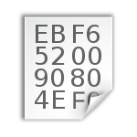
Complete Software Architecture
} }
Logical Client
Logical Server

Slide 27
Multiplayer Support (Continued)
You already saw how we synchronize data between the logical server and EBPP, but another challenge we faced in engineering this mod was synchronizing data between the logical client and the logical server.
The native Minecraft networking code uses a TCP socket to synchronize data between the client and the server. We were able to easily leverage existing Minecraft code to enable the logical server to send updates to the logical client.
Sending updates from the logical client to the logical server was a different story. We weren’t able to utilize native code and had to design another network communication protocol for this purpose.

Slide 28
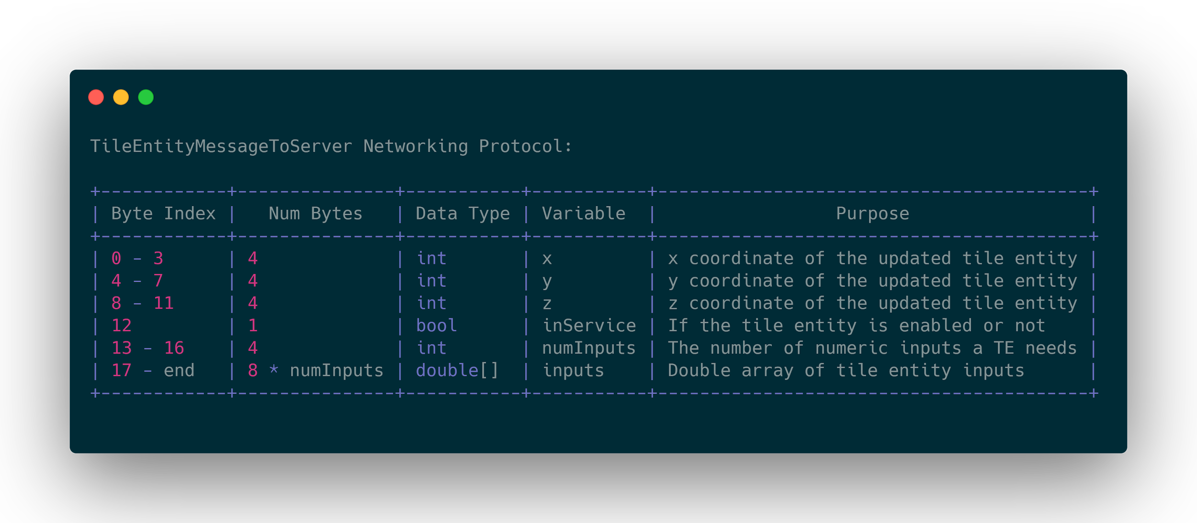
Client → Server Networking
This protocol was necessary for sending updates from the client GUI to the server. Since the data needed to do this was highly regular, we decided to use raw bytes format for maximum speed of encoding and decoding.

Slide 29
Requirement 4: Free and Open Source
We want Electric Blocks to be as accessible as possible to readily equip educators regardless of location or economic status. This is made possible by making Electric Blocks free to use.
Electric Blocks is also open source under the terms of GPL version 3. This license permits, anyone who wishes to view or modify the code to do so, and will aid in preventing project stagnation. GPL was chosen specifically with education and freedom in mind, to ensure that Electric Blocks will always remain free and open source.

Slide 30
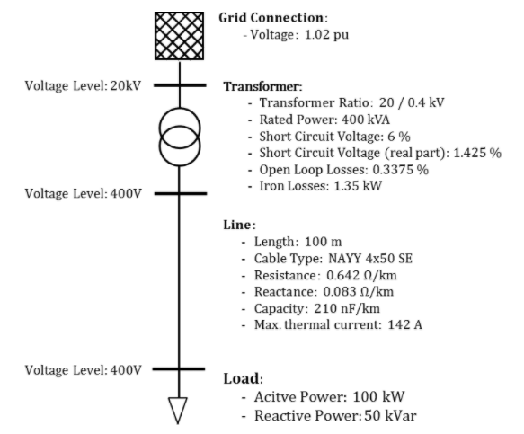
Design Validation Approach
We have already begun some basic testing by constructing example networks in PandaPower and verifying that the results match the expected output.
We have also already tested multiplayer functionality using a dedicated server with multiple players and were successful.
We plan to ramp up and expand testing as we implement more blocks and reach the end of our project.

Slide 31
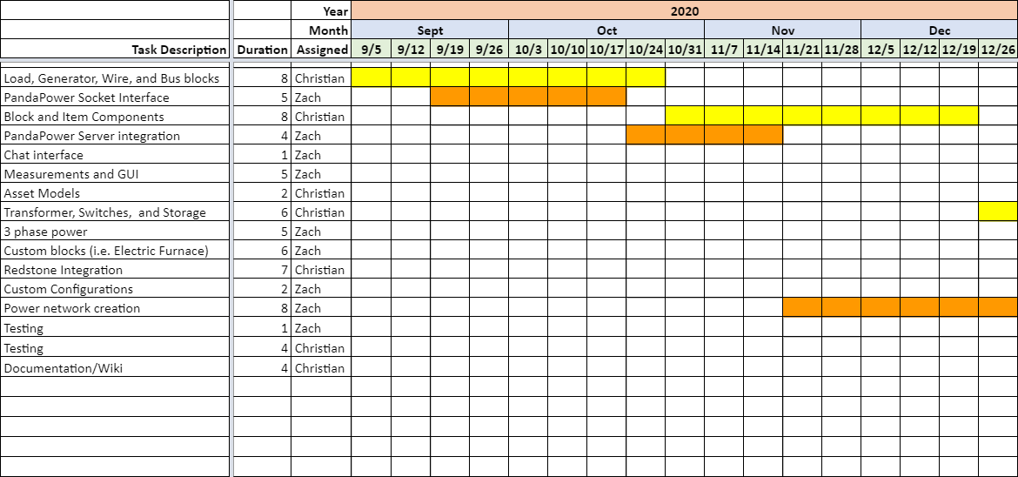
First Semester Schedule

Slide 32
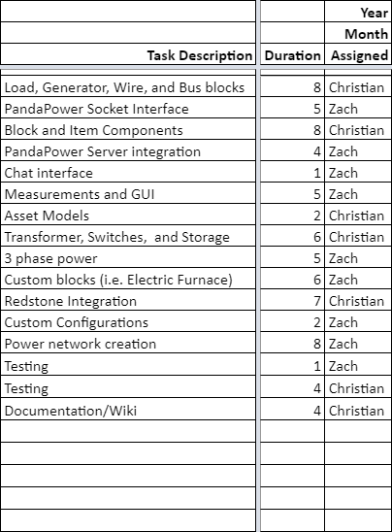
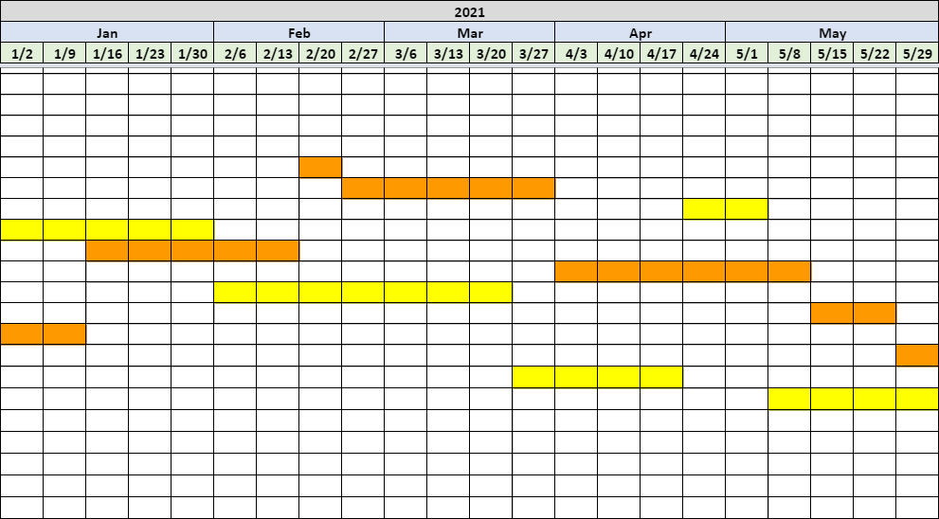
Second Semester Schedule

Slide 33
Schedule Analysis
We overestimated the time required to complete the tasks during the first semester schedule and we underestimated the time required to complete the tasks during the second semester schedule.
This incorrect estimation was primarily due to a documentation risk that we were unaware of. The Forge documentation is incomplete, rarely updated, and largely non-existent for much of the project.
To correct for this, we are removing custom asset models, custom blocks, and redstone integration entirely from our project scope and will be focusing on implementing the remaining blocks (storage, switches, standalone buses, etc.) as well as asymmetric three phase power.
Notes:
While we felt very confident in our progress by the end of the first semester, we have recently realized that we will need to scale down the scope of the project. One of the primary reasons that we needed to reduce the scope of our project is documentation risk. We didn’t realize that large chunks of the modding API are completely undocumented. This meant that a substantial portion of our time was dedicated to researching how to use the Forge API instead of actually using it. This research included trial and error, searching through forums, chatting with other mod developers, and frequent reverse engineering of uncommented and sometimes obfuscated code. It’s for those re

Slide 34

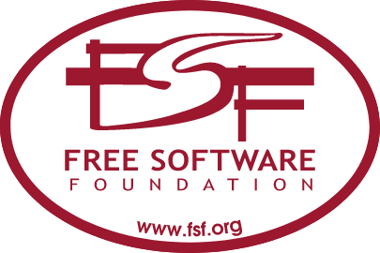

Budget
Our product did not have any budget allocated to it. We mentioned in our “Product Requirements” document that a VPS server could be useful for testing multiplayer functionality, but we were able to perform this testing locally on our own machines.
This project has not had any explicit costs other than our own development time so we’ve managed to stay within our budget of $0.00 and anticipate that we will continue to meet this requirement for the remainder of the project.
X

Slide 35
Project Risks
Our team had originally identified 3 main risks that could affect this project:
Legal risk since our project relies heavily on proprietary code from Minecraft.
Upstream risk due to possibility of breaking changes in APIs
Project management and scheduling risk.
Our risk analysis has proved to be correct on risks 1 and 2, but as we discussed on our schedule analysis slide, we did face an unknown documentation risk that impacted us.
Fortunately, we identified this issue and have adjusted our project scope accordingly. We are confident that we will still meet all product requirements.

Slide 36
Summary
This project was very complex and required:
3 Coordinating Programs
2 Programming Languages
3 Application Programming Interfaces
2 Network Communication Protocols
11,000+ Line Changes (78 per day 😲!)
123 Git Commits
Our design meets the requirements despite:
2 Team Members
0 EE or Power Engineering Experience
0 Budget

Slide 37
Conclusion
For more info, visit:
Github: https://github.com/ElectricBlocks
Website: https://electricblocks.github.io
Wiki: http://mindworks.shoutwiki.com/wiki/Electric_Power_Flow_Modeling_in_Minecraft
Special thanks to:
Professor Daniel Conte de Leon - Project Sponsor
Professor Bruce Bolden - Lead Instructor
This concludes our presentation.

